Slide 1
Standing Tall
Diversity still exists today.
Today I want to take one step closer in putting an end to it.

Slide 2
Mathew J. Myers
Born December 21, 1990
Birthplace: Manchester, NH
Parents: Marty & Sue Myers
  Averaged Sized
Siblings: Mackenzie 18, Michaeli 16, and Mitchel 14
  2 Brothers (Mac & Mitch)
    All average sized
Dwarfism: Achondroplasia
High School: Trinity HS in Manchester, NH
College: UNH ‘13
  Major: Communications
Sports: Hockey, Golf, Baseball, Soccer

Slide 3
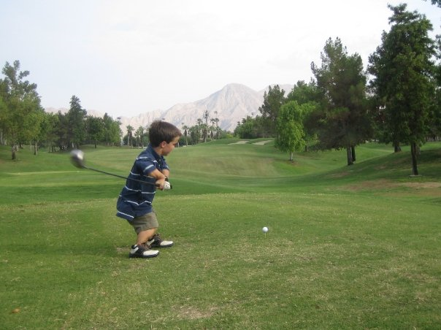
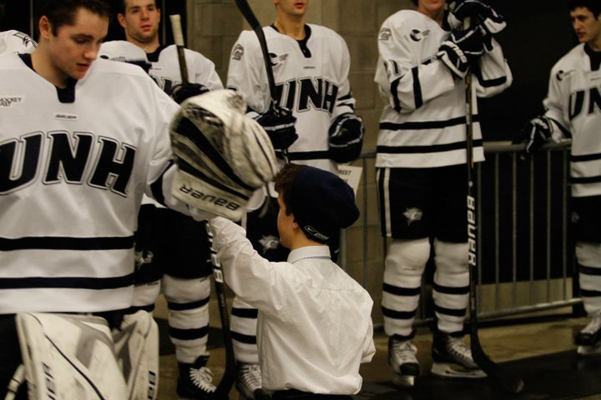
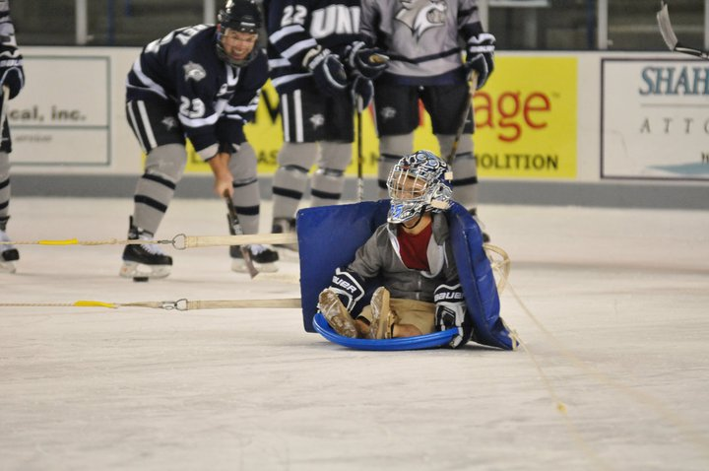
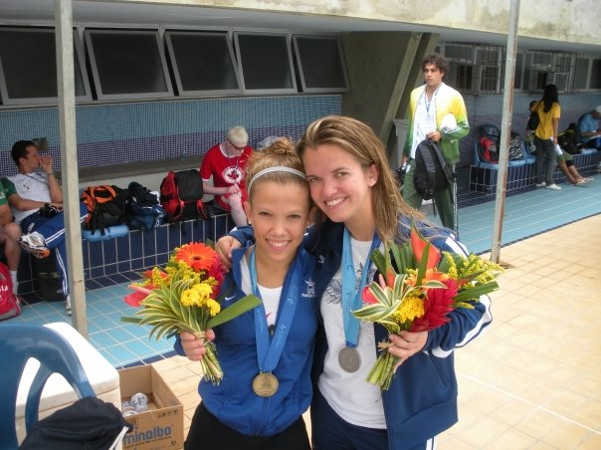

Slide 4
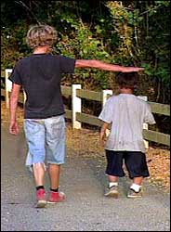
Achondroplasia
A genetic disorder that results in abnormally short stature
It is the most common cause of short stature with disproportionally short limbs.
The average adult height is 52 inches or 4 feet 4 inches for a male and 49 inches or 4 feet 1 inch for a girl.
Achon is one of the oldest types of birth defects.
The frequency birth rate of Achon Dwarves is 1 in 25,000.

Slide 5
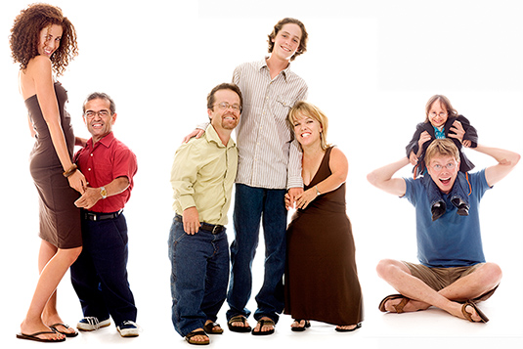
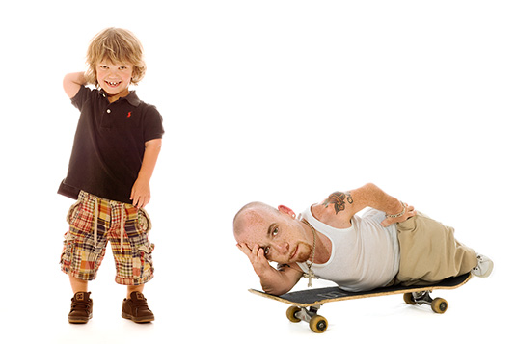
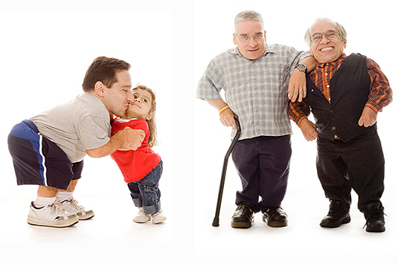
Photo Credit: Gary Parker

Slide 6
Characteristics:
Relatively long torso, short arms & legs, and disproportionate shortening of the limbs (arms, legs, fingers).
Large head with a prominent forehead.
Fingers appear short and the ring finger and the middle fingers diverge giving the hand a “V” shape when you put the hands together.
Ear infections, Dental Crowding, Obesity

Slide 7
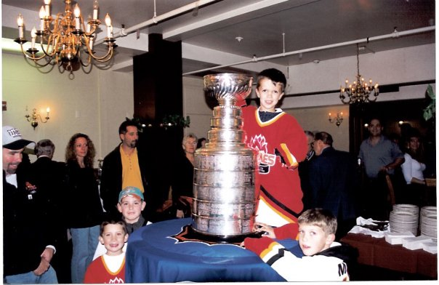
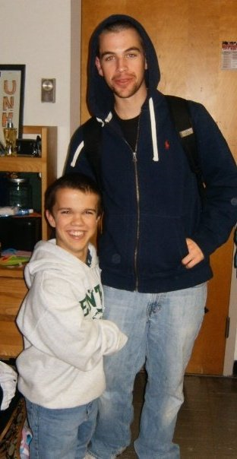
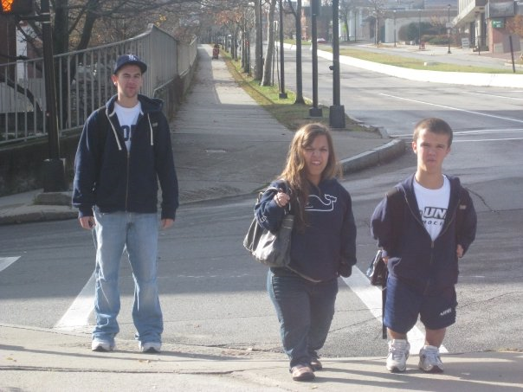

Slide 8
The “M” Word
Refers to the word midget
Considered offensive to most little people
History perceives as a dwarf being used as an act for laughs in the circus.
Just rolls off the tongue nasty
Other words to use instead: little, short, dwarf, small, or quit simply their name.

Slide 9
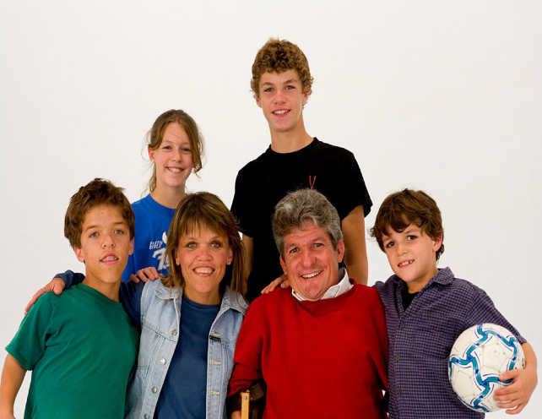
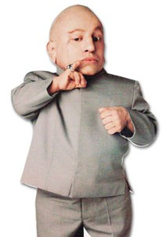
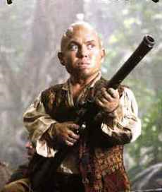
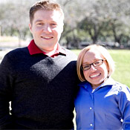
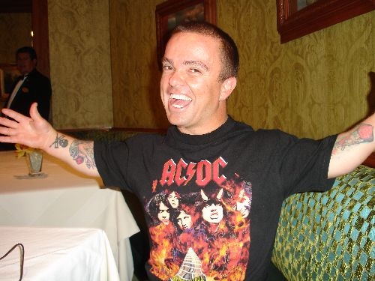
Famous Dwarves:
The Roloffs: Matt, Amy, Zach, Jeremy, Molly, Jacob
  TLC’s hit show Little People Big World
Martin Klebba
  Pirattes of the Carribean: At World’s End, Hancock, Scrubs, The Cape
Bill Klein and Jen Arnold
  The Little Couple (TLC)
Jason Acuna
  Wee-Man
Verne Troyer
  Austin Power’s “Mini-Me”
Soon to be: Mat Myers

Slide 10
I want to show everyone that I am no different,
I am just as capable of completing every task
that you and you and you can complete.
Dynamite comes in small packages.
I never ask for help, I never ask for extra time,
and I will never let you down.
You take one step, I take three
I'm doing it for the people who don't have a say,
who can't have a say, who won't have a say.
Do it big and let the
small fall under that
When you’re different you work hard to
be like everyone else. When you’re
like everyone else you
work hard to be different.
Everyone has a story, what’s yours?

